Slide 1

Introduction to Big Data in Healthcare
Oliver Hugh MSc CStat
oliverhgh86@gmail.com
https://github.com/OliverHughStats/SWB_Presentation
11th August 2023

Slide 2
Introduction
Human Biology and Mathematics, BSc – 2016, Keele University, UK
Epidemiology and Biostatistics, MSc – 2019, Leeds University, UK
Contract Statistician for Abbott Medical Devices, Oxford, UK - 2016 – 17
Senior Statistician for Perinatal Institute, Birmingham, UK - 2017 – Present

Slide 3

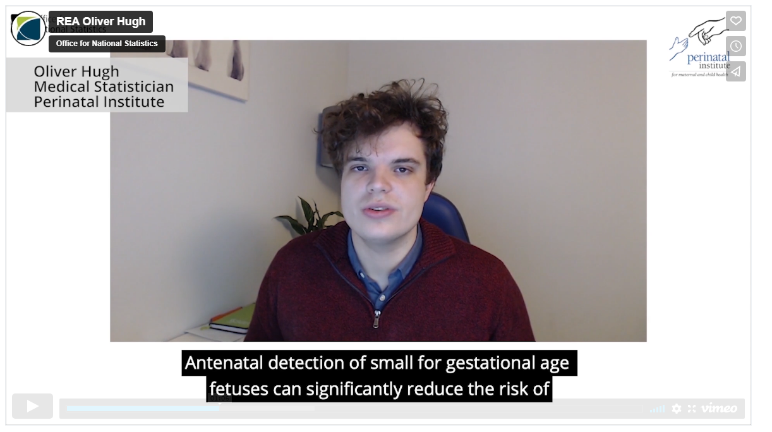
Introduction
Numerous peer-reviewed publications
A project performed in collaboration with the Office for National Statistics has won a research excellence award presented by national statistician Sir Ian Diamond https://bit.ly/37f6jt9

Slide 4
Aims
To distinguish between prediction and causal modelling
Be aware of the power of big data and the different areas where it can be used
To be aware that more data, does not necessarily mean more information

Slide 5
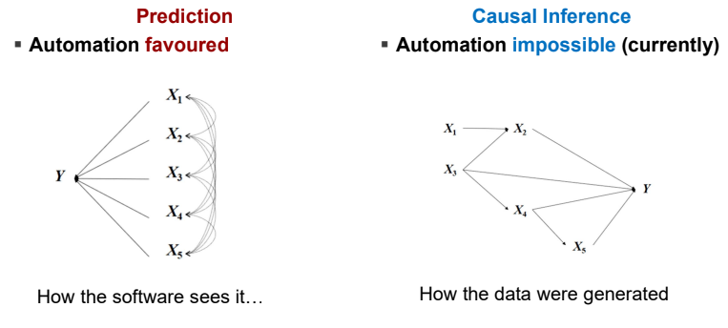

Slide 6
What is Big Data?
Big Data is defined as large, fast or complex data, requiring increasing complex packages to analyse – the concept gained momentum in the early 2000’s.
Often combined from multiple sources, requiring a specialist to identify sources of bias
For instance, if you’re combining two datasets from two hospitals and one is missing ‘Smokers’, this needs to be accounted for.

Slide 7
Why is Big Data Important?
The value of big data lies not from the number of rows or columns but how you use it:
Streamline resource management
Improve operational efficiencies
Optimise product development
Identify new opportunities
Enables smart decision making

Slide 8
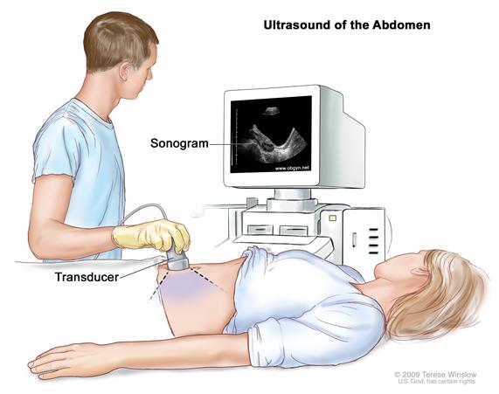
Why is Big Data Important? Streamline resource management
Within the NHS – ultrasound scans are a resource that is in short-supply, and cannot be provided to everyone.
Big Data is used to identify the most significant factors for morbidity and guidelines are written to designate these pregnancies as ‘increased risk’ and put on a serial scanning pathway.
Low risk women are placed on a fundal height pathway.

Slide 9
Why is Big Data Important? Improve operational efficiencies
By analysing previous data, you can identify areas of improvement to continuously improve in subsequent years

Slide 10
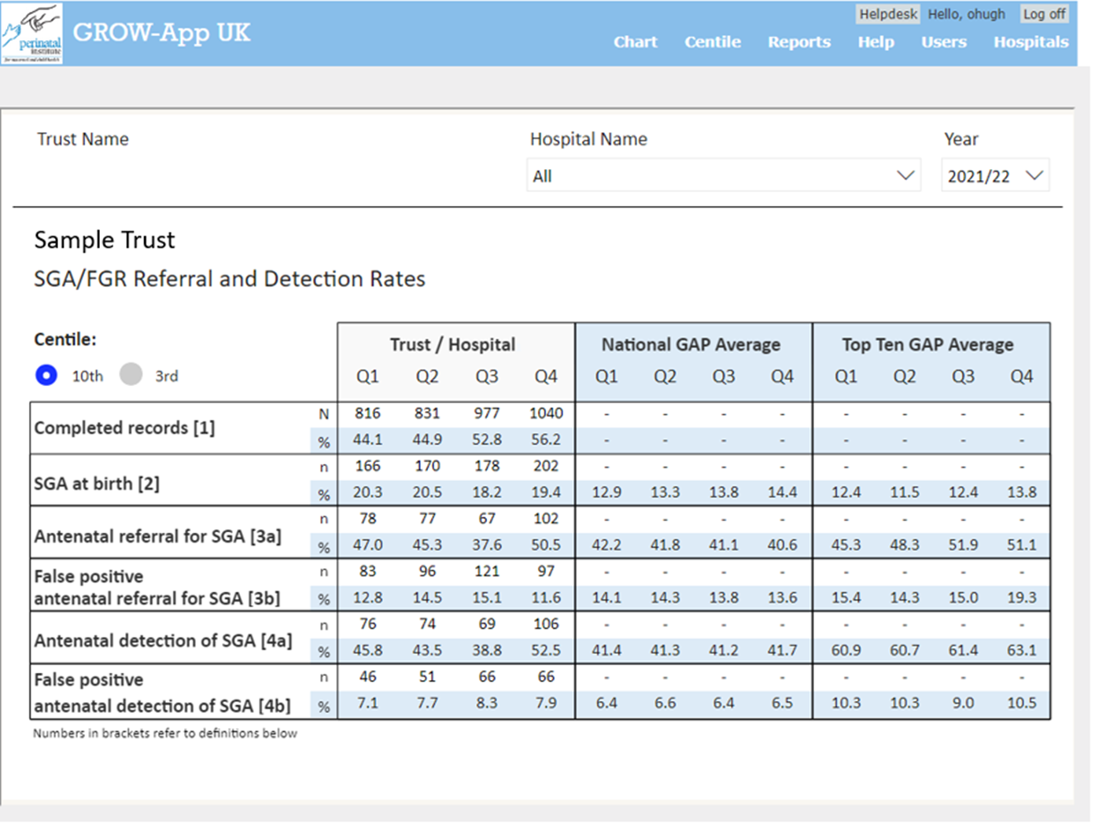
Why is Big Data Important? Improve operational efficiencies

Slide 11
Why is Big Data Important? Improve operational efficiencies
Displays personalised data to individual trusts with data security imposed
Updated on a regular basis to allow clinicians to monitor improvement
Used in management meetings to identify areas of improvement – all performed within Microsoft PowerBI

Slide 12
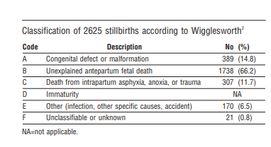
Why is Big Data Important? Identify new opportunities
By identifying shortcomings in healthcare, you can allow for improvement for instance:
In the UK, according to the Wigglesworth criteria 60% of stillbirths were classified as unknown¹
Gardosi J et al. Classification of stillbirth by relevant condition at death (ReCoDe): population based cohort study. BMJ. 2005;331(7525):1113–7.

Slide 13
Why is Big Data Important? Identify new opportunities
Big data allowed the team to identify the main causes of stillbirths and found 43% are due to fetal growth restriction.
Research since 2005 has focused on reducing fetal growth restriction which has since contributed to the year-on-year drop in stillbirth rates

Slide 14
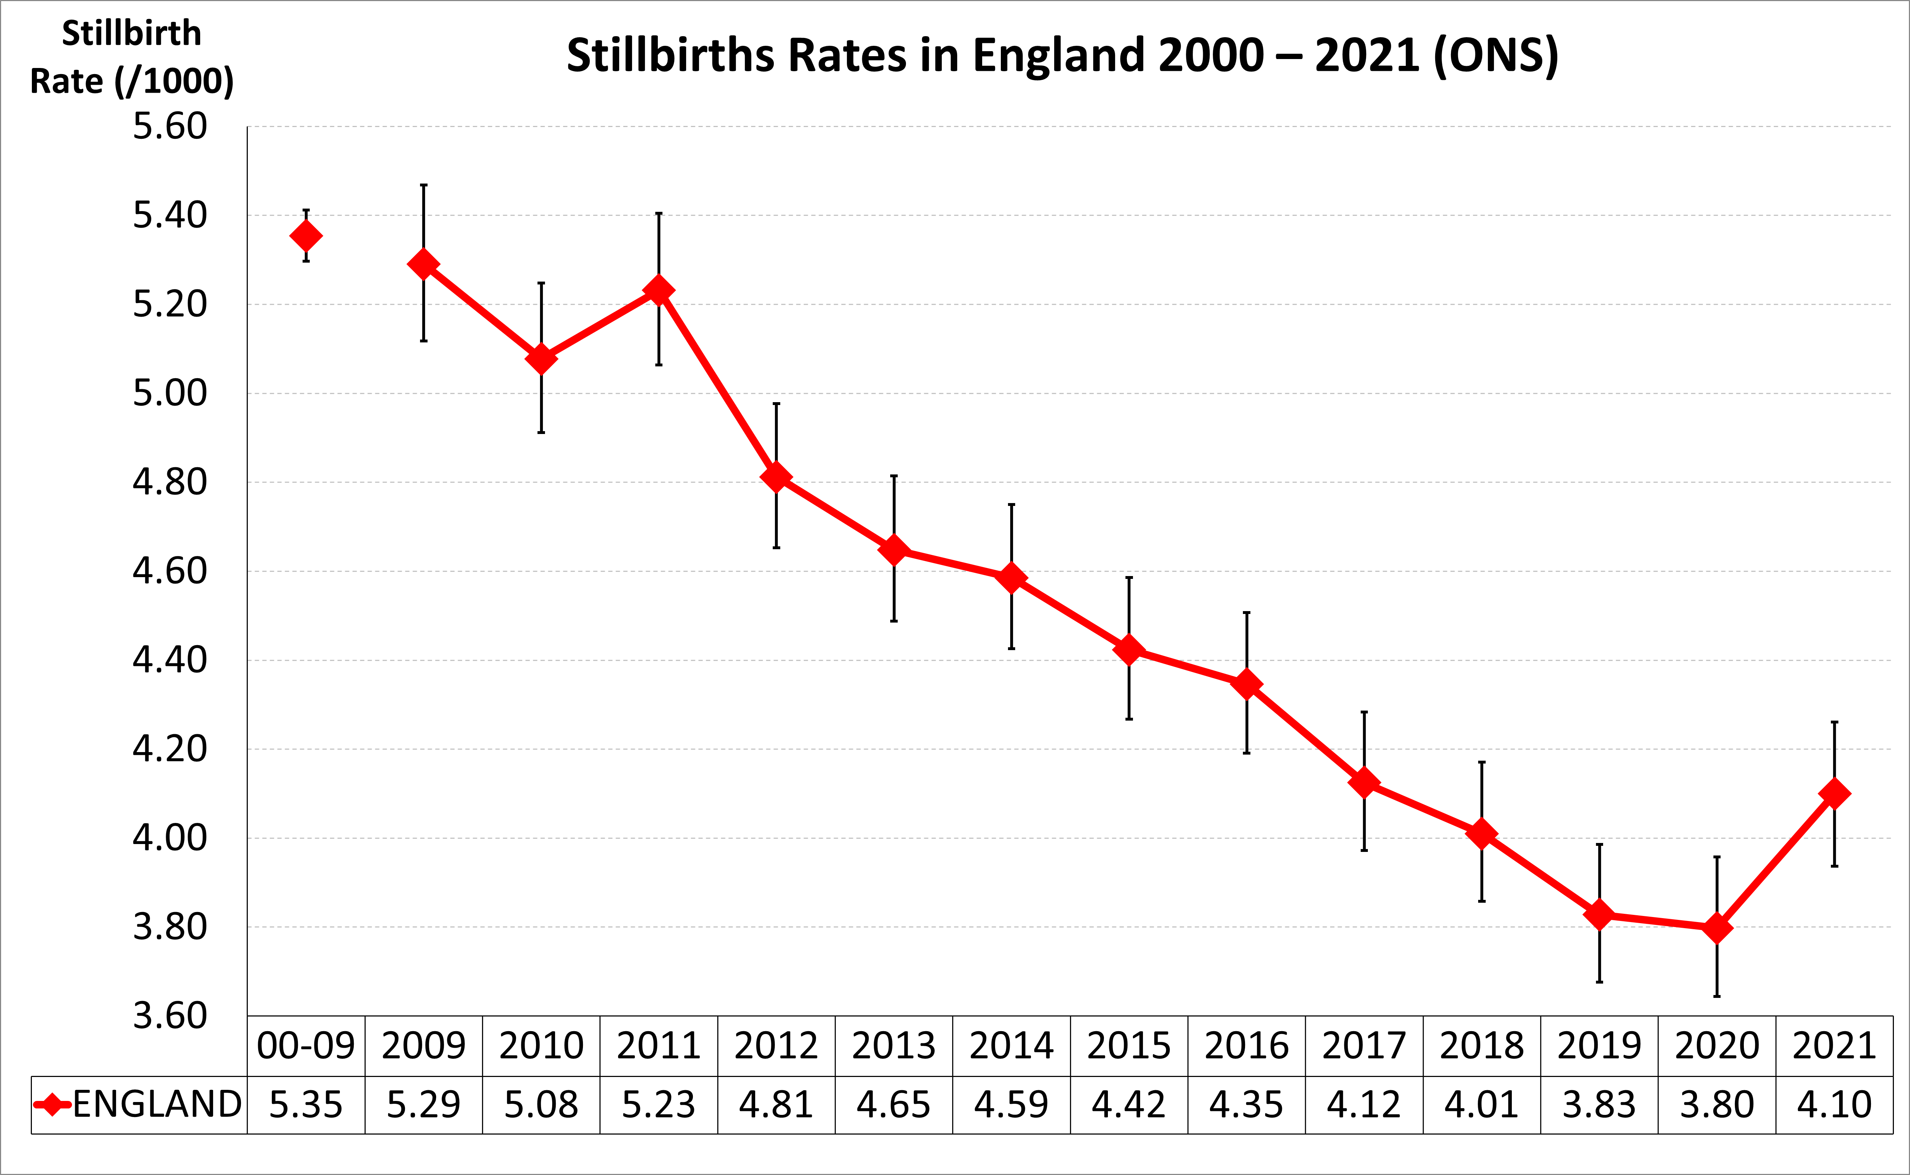

Slide 15
Why is Big Data Important? Enables smart decision making
With the aid of machine learning algorithms, from vast amounts of data – clinical decisions can be automated.
Developments are already underway to allow this to be used within X Ray and cancer diagnoses

Slide 16
How is Big Data Analysed
Big Data requires cleaning, and special considerations for issues such as missing data that can influence the results of an analysis
Requires more complicated packages than Microsoft Excel
Typically, a statistical software package, where every step that’s performed can be inspected, repeated and reviewed
These include Python, SQL, R, SAS or MATLAB

Slide 17
Background
UK Stillbirth rates amongst worst in Western Europe
have not changed for last 10-20 years

Slide 18
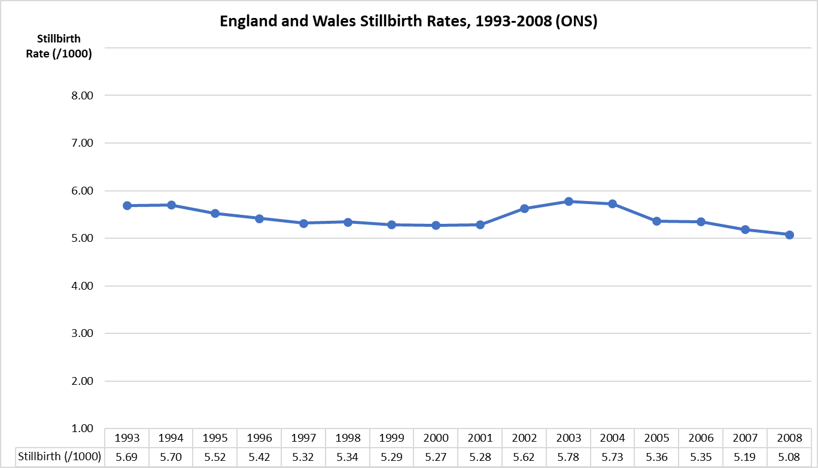

Slide 19
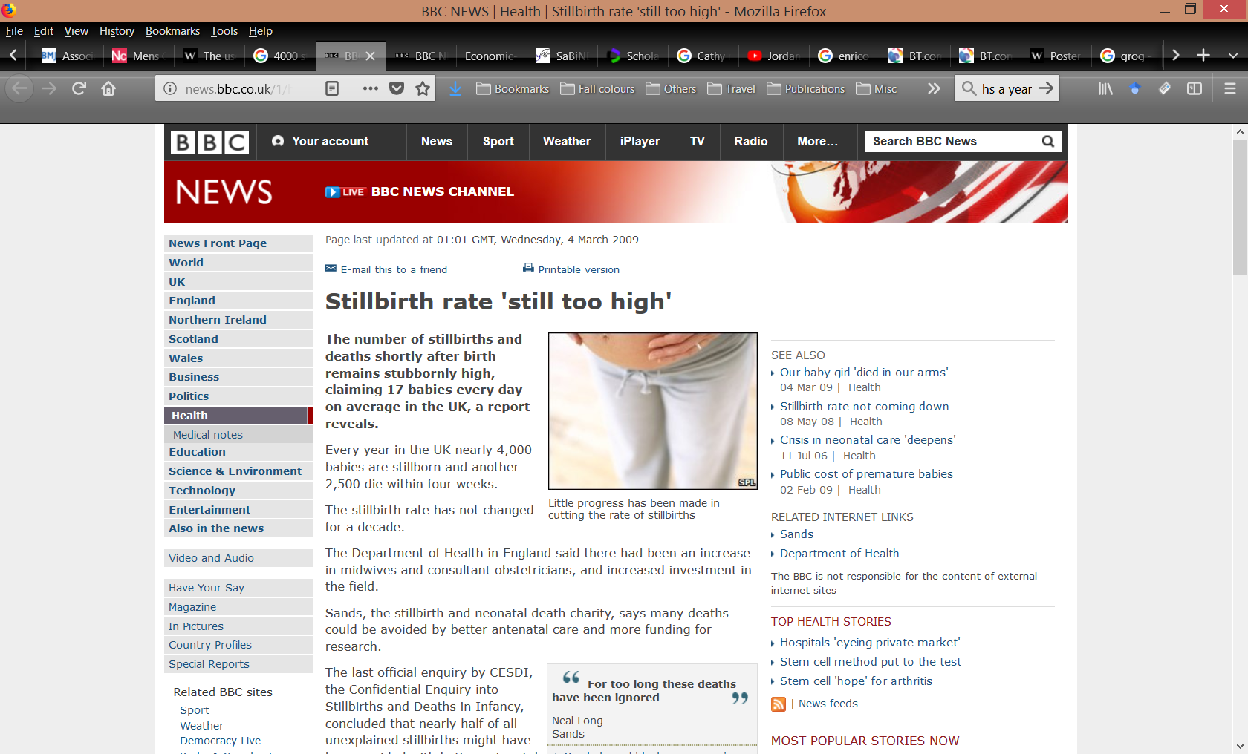

Slide 20
Background
UK Stillbirth rates amongst worst in Western Europe
have not changed for last 10-20 years
Most were designated ‘unexplained’
But majority of ‘unexplained’ are Fetal Growth Restricted

Slide 21
Background
UK SB rates amongst worst in Western Europe
have not changed for last 10-20 years
Most designated ‘unexplained’
But majority of ‘unexplained’ are Fetal Growth Restricted (FGR)
Majority of FGR not detected during pregnancy
Antenatal detection reduces stillbirth risk

Slide 22
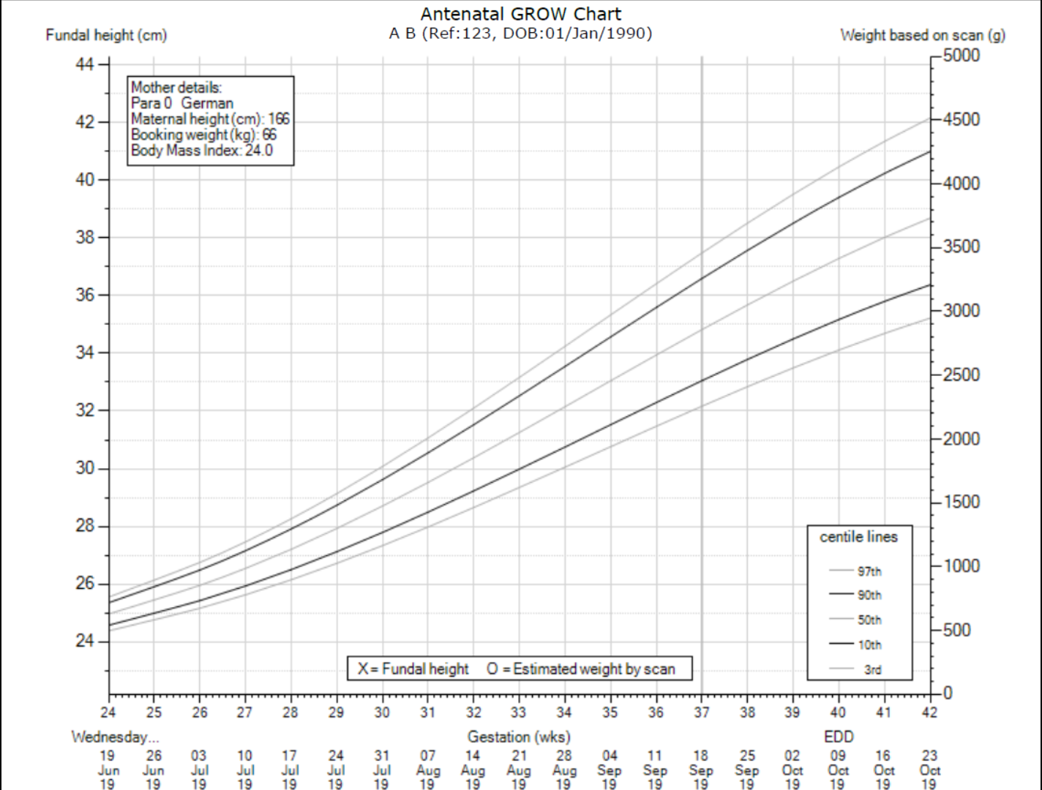
Growth Assessment Protocol (GAP)
Local, regional, national workshops
E-learning - theoretical & practical
Competency assessment
Protocols / care pathways
Audit tools - detection rates; reports (PowerBI)
- review of missed cases
Local GAP leads (lead midwife, obstetrician, sonographer)
Help desk support
Customised growth charts

Slide 23

Customised growth charts Gestation Related Optimal Weight (GROW) adjusted for maternal height, weight, parity and ethnic origin

Slide 24
Methods – Births dataset
We used the ONS Births dataset from 2008 (before the first regional roll-out of GAP) to 2017 (the latest available data at the time).
Welsh births were excluded due to national programs that differed from England.
Non-NHS deliveries were also identified within the dataset and excluded.

Slide 25
Methods – Identifying NHS trusts
The ONS Births dataset does not identify NHS trusts but does collect postcode of place of birth.
We were able to create a dataset of NHS Trusts and the postcode for each of their sites using publicly available information.¹
We were able to join this to the births dataset to identify trust of birth in >99.9% of pregnancies.
NHS Trust Contact List. 2019. https://www.nhs.uk/servicedirectories/pages/nhstrustlisting.aspx

Slide 26
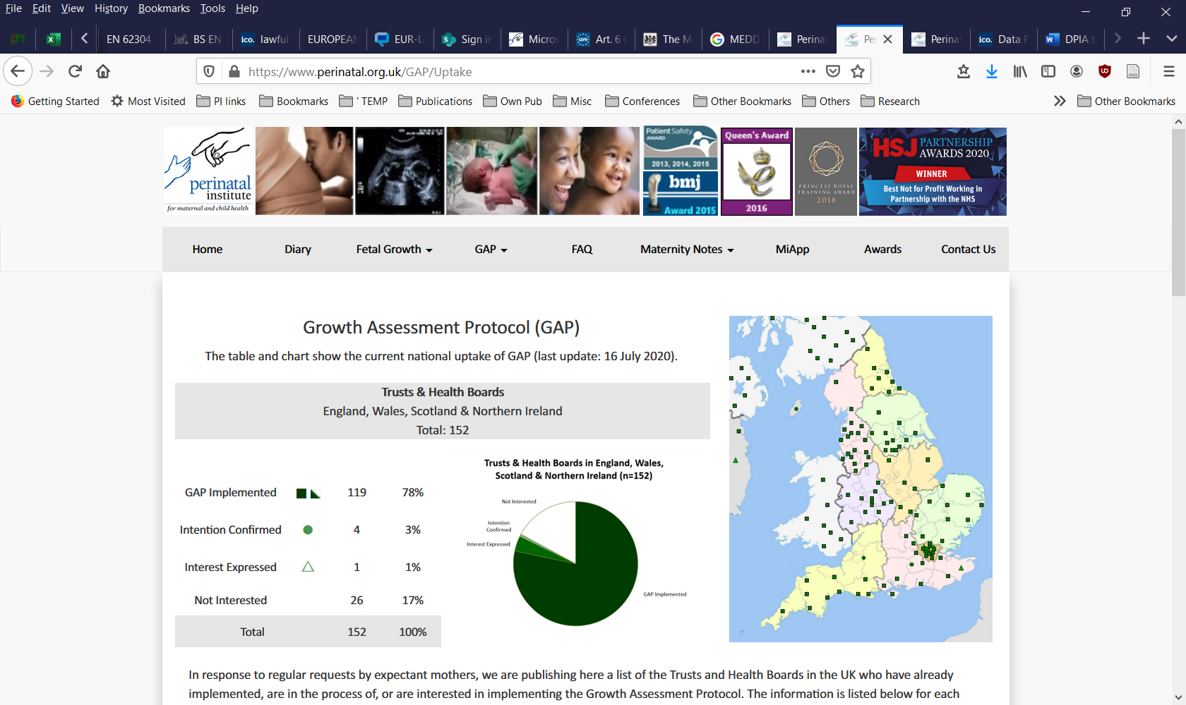
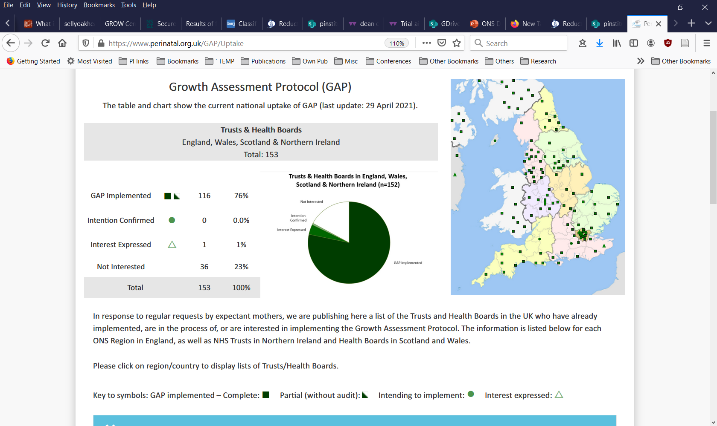
Methods – Classification of Trusts
GAP is implemented in over 75% of NHS to varying degrees¹
1. Growth Assessment Protocol Uptake. 2020. https://perinatal.org.uk/GAP/Uptake

Slide 27
Methods – Classification of Trusts
We classified trusts into three categories:
Complete – Trusts who audit and submit at least 75% of their birth outcomes. Represents full engagement in GAP program.
Partial – Trusts who audit less than 75% of their birth outcomes
Non-GAP – no interaction with GAP program

Slide 28
Methods: Classification of NHS Trusts
In 2017, there were 133 English trusts classified into the following:
 | NHS Trusts |  | Submission Rate
 | N | % | Median | IQR
Non-GAP | 39 | 29.3 | 0 | 0.0 - 0.0
Partial GAP | 29 | 21.8 | 23.3 | 0.9 - 59.9
Complete GAP | 65 | 48.9 | 92.7 | 86.9 - 96.8

Slide 29
Methods – Classification of Trusts
An additional subgroup of top-20 best performing GAP trusts was also identified (by their SGA detection rates)

Slide 30
Methods – Statistics
Stillbirth rates were calculated for each group in 2008 (pre-GAP) and 2017 (latest data) and compared using a proportions Z test
Additional mixed-effects logistic regression was performed for the 2017 data while adjusting for confounders including deprivation
Postcode of maternal residence was recorded and deprivation was derived by joining the postcode of maternal residence with lower layer super output area and IMD-15 score

Slide 31
Database Structure
Group Level
Individual Level
Birth
Outcome
Birth
Outcome
Trust
Birth
Outcome
Birth
Outcome

Slide 32
Results - Exclusions
 | Excluded | Remaining
 | n | n | %
All births England & Wales 2008 - 2017 |  | 7,092,750 | 100
Births outside NHS | 25,020 | 7,067,730 | 99.6
Place of birth not recorded | 180,579 | 6,887,151 | 97.1
Place of birth postcode not mapping to unit | 2,400 | 6,884,751 | 97.1
Births mapped to units in Wales | 323,191 | 6,561,560 | 92.5

Slide 33
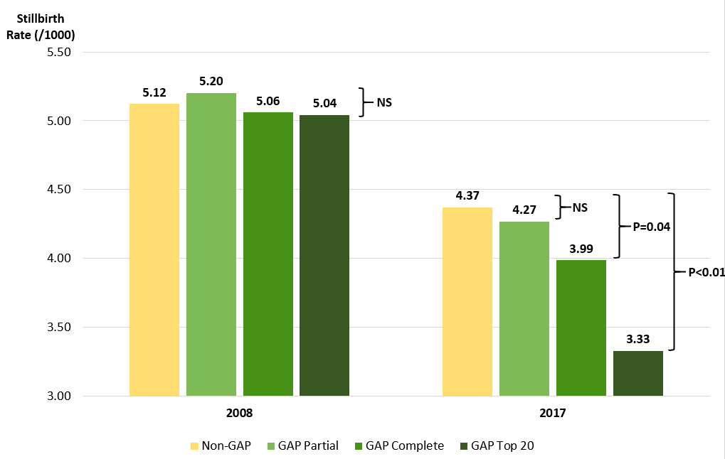
Results – SB rates by GAP classification
Notes:
Overall reduction in stillbirths, likely to be associated with an increased level of awareness of avoidability their association with fetal growth restriction, and national guidelines.
GAP units had a significantly greater decline in stillbirth rates, especially in units which had a more complete implementation, with extensive training, audit and adherence to protocols.
The greatest reduction has been observed in the subgroup of units with highest detection rates.

Slide 34
Results – SB rates by GAP classification
Notes:
Overall reduction in stillbirths, likely to be associated with an increased level of awareness of avoidability their association with fetal growth restriction, and national guidelines.
GAP units had a significantly greater decline in stillbirth rates, especially in units which had a more complete implementation, with extensive training, audit and adherence to protocols.
The greatest reduction has been observed in the subgroup of units with highest detection rates.

Slide 35
Results – SB rates by GAP classification

Slide 36
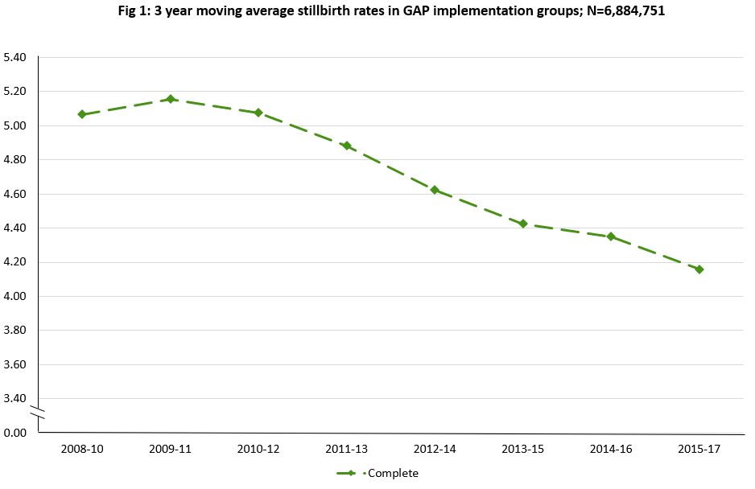
Results

Slide 37
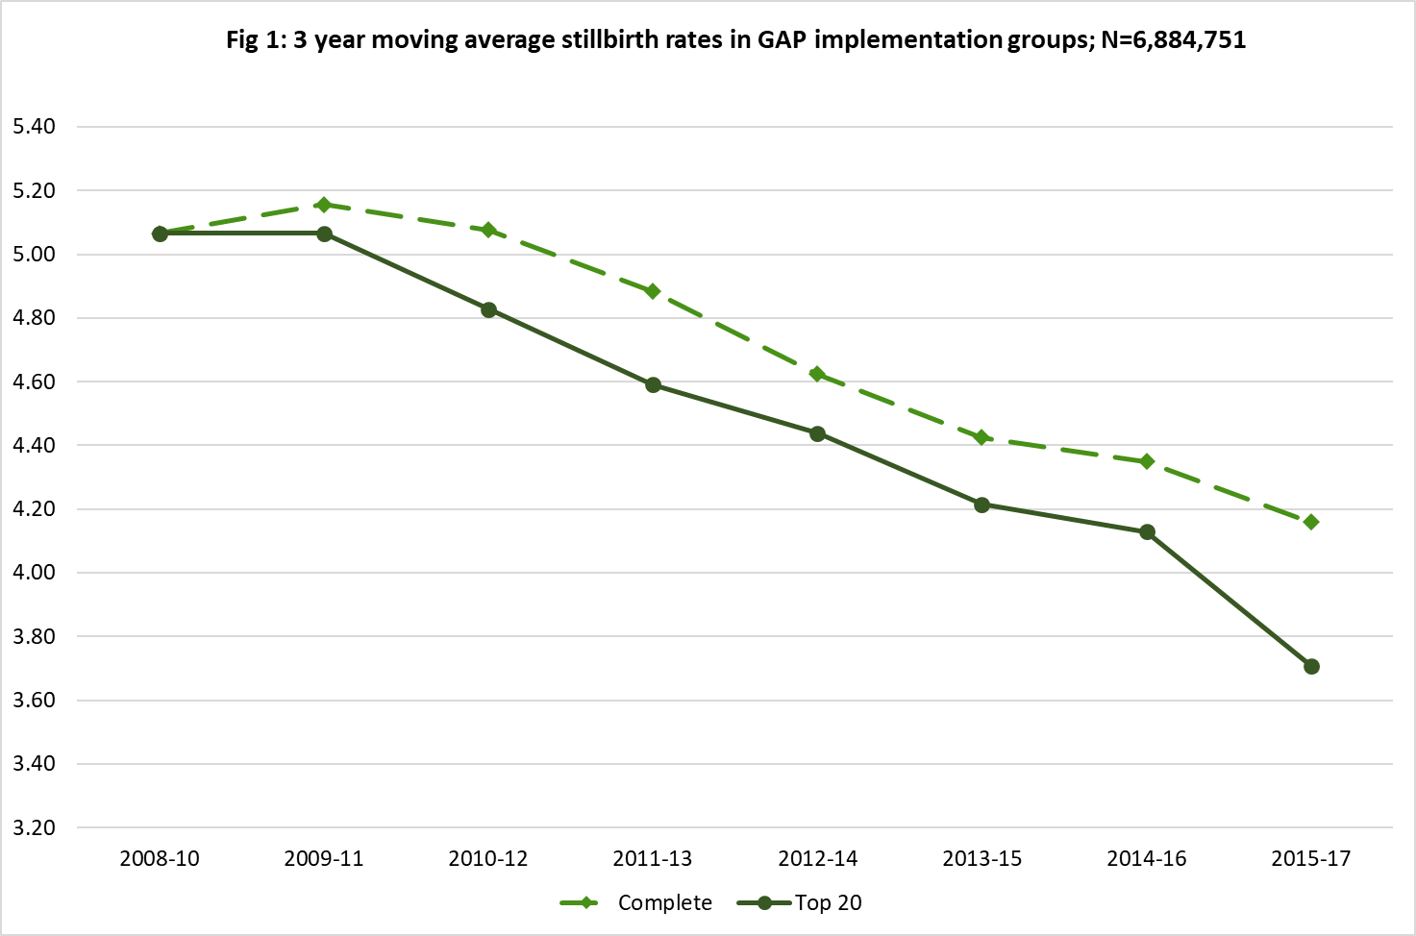
Results

Slide 38
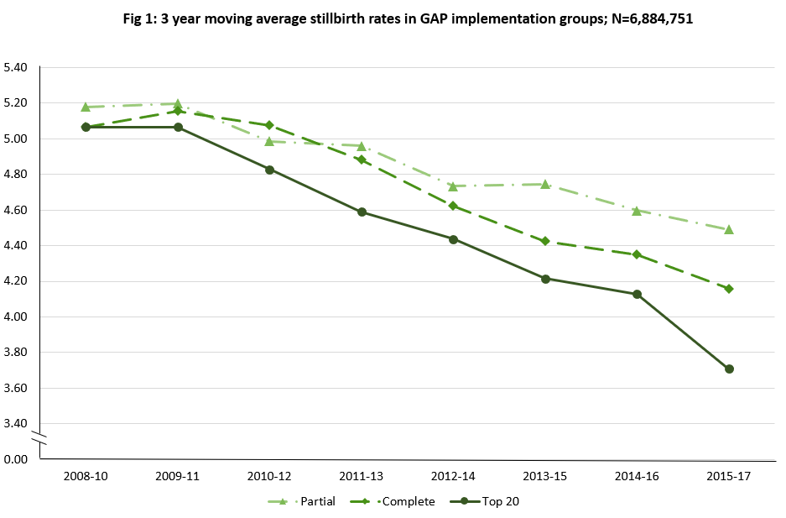
Results

Slide 39
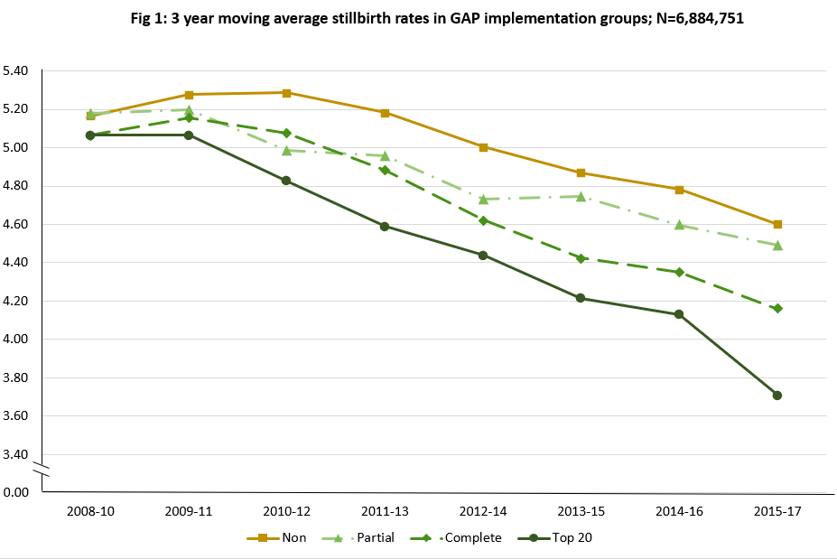
Results

Slide 40
Logistic regression analysis
To quantify the effect of GAP after adjusting for confounding factors, e.g. deprivation and maternal age.
N= 592k births in 2017

Slide 41
Results – Logistic Regression
Non-GAP Units vs Complete GAP Units - OR : 0.89 (CI: 0.79 - 1.00) ; P<0.05.
Non-GAP Units are 12% more likely to experience a stillbirth than GAP units
Non-GAP units vs GAP Top-Twenty Units OR : 0.76 (CI: 0.64 – 0.90); P<0.05.
Non-GAP Units are 32% more likely to experience a stillbirth than Top-20 units

Slide 42
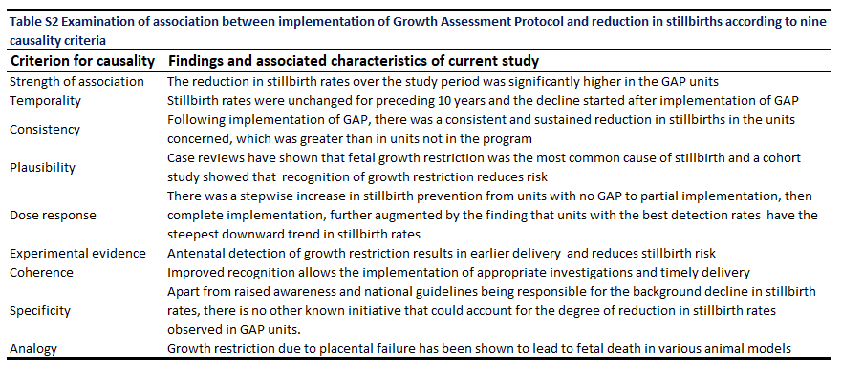
Causality – Bradford Hill Criteria

Slide 44
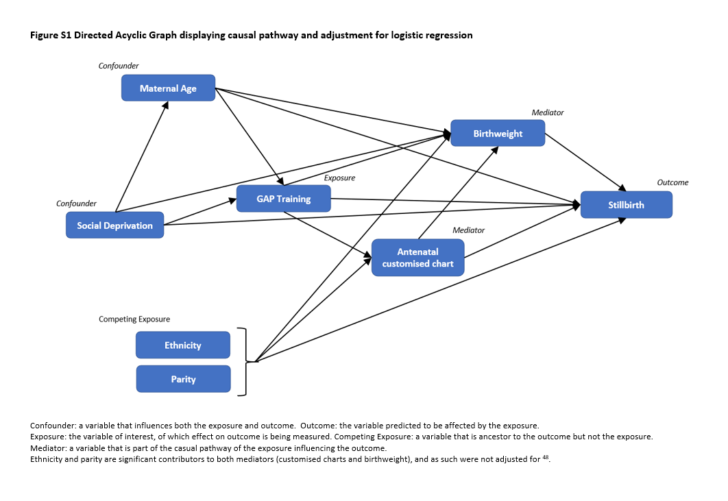

Slide 45
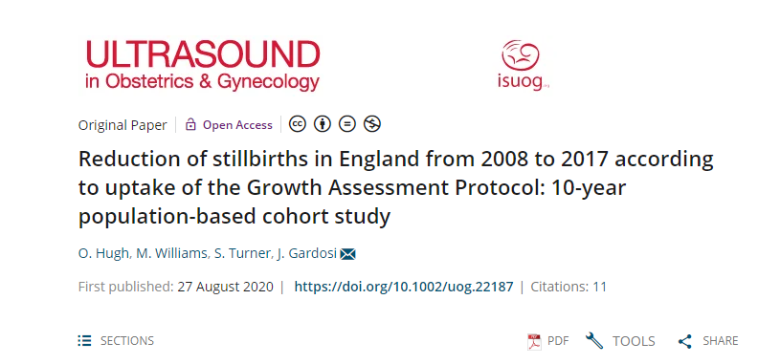

Slide 46
Impact
Evidence and motivation for GAP trusts to maintain a focus on fetal growth surveillance and audit.
Directed more research into the mechanisms of fetal growth restriction and what more can be done to identify, prevent and reduce stillbirth rates
An evidence base for non-GAP trusts to adopt GAP
It’s provided awareness to non-maternity colleagues about the importance of preventing stillbirths, and what more could be done in their own datasets

Slide 47

Big Data
Prediction
Prediction typically is putting all available data into a model to predict an outcome.
You need to be mindful of missing data in this scenario and the type of outcome.
Typically assessed using R² values or RMSE.

Slide 48
Big Data
Prediction – Artificial Intelligence
Machine Learning / neural networks such as Random Forest or Support vector machines don’t have any assumptions unlike standard models
Supervised – to identify and predict an outcome
Unsupervised - to identify patterns within a dataset

Slide 49

Big Data
Prediction – Artificial Intelligence
Overfitting

Slide 50
Big Data
Prediction – Artificial Intelligence
Overfitting is where a model is only relevant to the dataset it’s trained on – in this scenario you’ll see models getting close to predicting 100% of the outcome
Not relevant outside of your internal dataset
How do you get round this?

Slide 51
Big Data
Prediction – Artificial Intelligence
Cross-validation – using a separate dataset to apply your model to
Training – The dataset used to train your model
Test – The dataset used to test your model
But what if the model is relevant to your test dataset only and not to outside datasets?

Slide 52
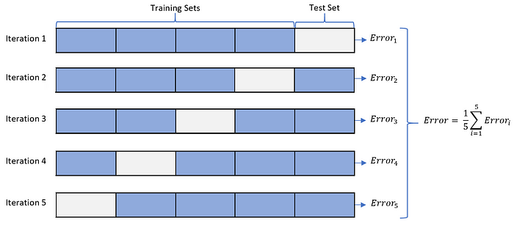
Big Data
Prediction – Artificial Intelligence
Common question within prediction modelling:
K-Fold Cross validation

Slide 53
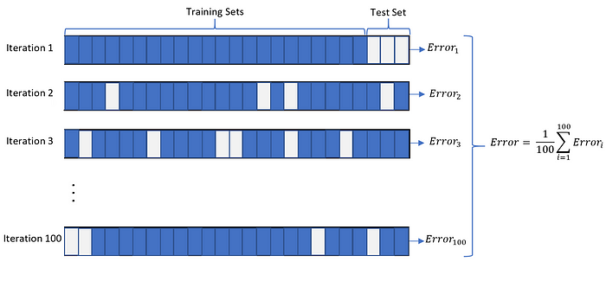
Big Data
Prediction – Artificial Intelligence
Common question within prediction modelling:
Monte-Carlo cross validation

Slide 54
Dangers of Big Data
Security and Privacy
Data in unintended hands can be used for the wrong reasons.
Scams – eg knowledge of sensitive health information being used to contact and then scam an individual with cheaper faster treatment
Disinformation – commonly used in social media companies for advertising but also by political parties to target advertisement
In 2016, the General Data Protection Regulation allows organisations to be fined up 20 million euros or 4% of their total turnover

Slide 55
Dangers of Big Data Misinterpretation
Running causal models as prediction models – has misinterpretation problems
One of the most well-known examples of misinterpretation of big-data is the birthweight paradox

Slide 56
Dangers of Big Data Misinterpretation
Smoking causes infant death
Smoking causes lower birthweight
Lower birthweight causes infant death
Birthweight
Smoking
Stillbirth

Slide 57
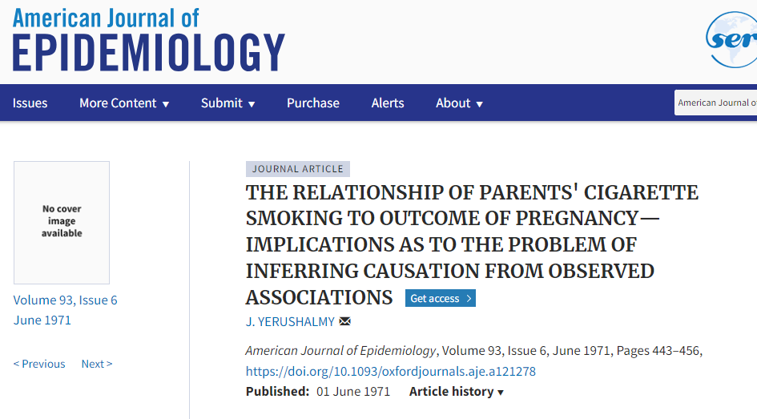
Dangers of Big Data Misinterpretation
First observed by Yurushalmy in 1971
He examined smoking's effect on infant death, stratified by ethnicity and birthweight

Slide 58
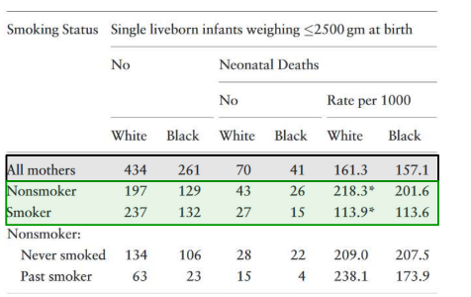
Dangers of Big Data Misinterpretation
Yerushalmy found the rate of stillbirth in non-smokers was higher than in smokers

Slide 59
Dangers of Big Data Misinterpretation
Mixed interpretations:
Perhaps smoking has a beneficial effect during pregnancy?
Perhaps there’s some clinical previously unexplored pathway that would explain this?

Slide 60
Dangers of Big Data Misinterpretation
The relationship between smoking and stillbirth is weaker than low birthweight and stillbirth
Low birthweight in absence of smoking implies more serious reasons
Birthweight
Smoking
Stillbirth

Slide 61
Dangers of Big Data Misinterpretation
To prevent these errors, drawing causal diagrams and identifying each variables role can be key
Other avenues for misinterpretation include missing data and outliers

Slide 62
Why is Big Data Important? Missing Data
Simply dropping missing data can result in under-powered analyses or even bias
For instance, pregnancies from deprived regions are less likely to attend appointments – simply excluding these rows, leads to a population that is not without a deprived component which isn’t reflective of a general population

Slide 63
Dangers of Big Data Missing Data
Options:
Exclude
Assume the negative
Assume the average
Apply machine learning algorithms such as Multiple Imputations by Chained Equations (MICE)

Slide 64
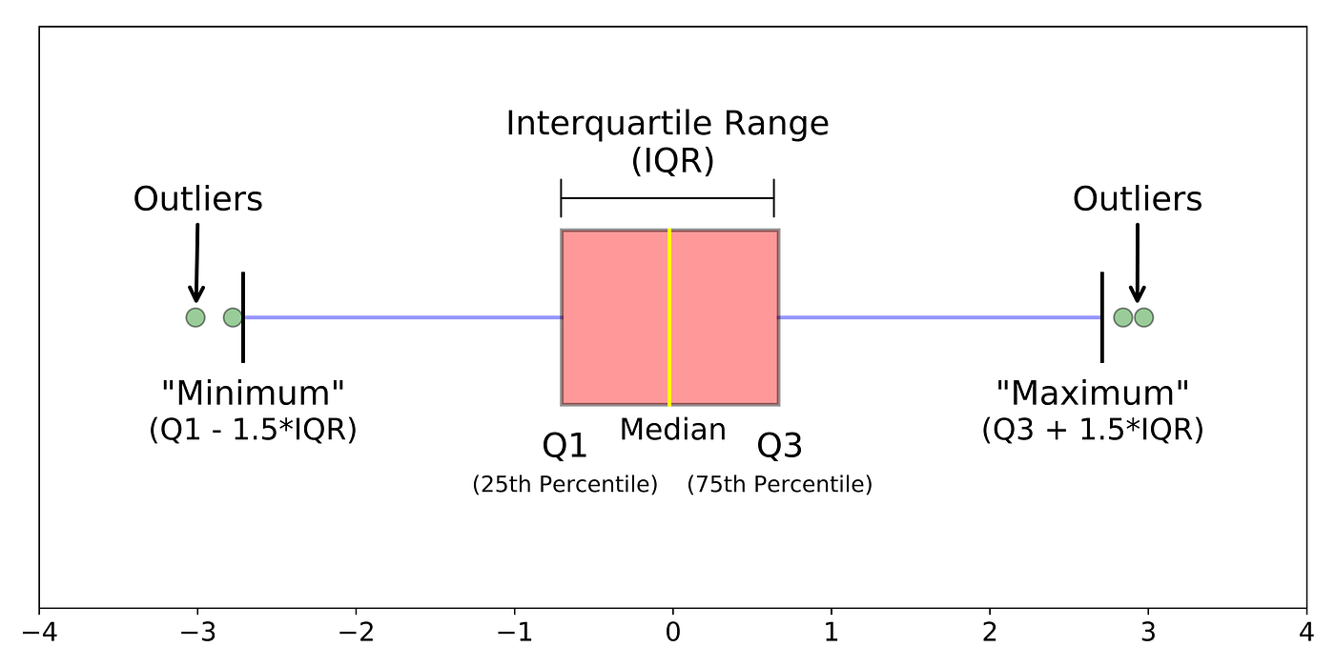
Dangers of Big Data
Outliers
Outliers can influence regression and average analysis and result in bias
An outlier is defined as a value that is + or – 3 SDs away from the mean or 1.5*IQR from the median

Slide 65
Why is Big Data Important? Outliers
Are these outliers possible?
Are they OK to simply exclude or is it better to assume the outlier is erroneous and treat the data as missing.

Slide 66
Exercise
https://github.com/OliverHughStats/SWB_Presentation

Slide 67
Any questions?
https://github.com/OliverHughStats/SWB_Presentation

